Slide 1
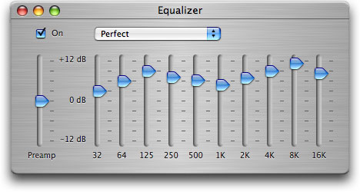
Filters
And filtering in the Web Audio API

Slide 2
Simple digital filter
Linear time invariant digital filters are at the heart of many audio effects
Current output y[n] is a function of summed and weighted values of
Current input x[n]
Past input x[n-1], x[n-2], …
Past output y[n-1], y[n-2], …
Difference equation:
a₀ y[n] + a₁y[n -1] + …+ a_{N}y[n-N] =b₀x[n] + b₁x[n-1] +…+ b_{M}x[n-M]
Examples:
Simple delay: y[n] = x[n-D]
Averaging: y[n] = 0.5x[n] + 0.5x[n-1]
Exponential smoothing: y[n] = cx[n] + (1-c)y[n-1]

Slide 3

Simple digital filter
Filter can be completely described by coefficients
a1, ..., aN, b0, b1, ..., bM
Filters affect the magnitude and phase of frequencies in a signal
Input: x[n]=sin(n)
Apply filter: y[n]= 0.5x[n] + 0.5x[n-1]
y[n]= (sin(n) + sin(n-1))/2
= cos(1/2) sin(n-1/2)
Phase change
Magnitude change

Slide 4
Ideal filters
B
1
Lowpass
1
Bandpass
Y-axis: Output magnitude
X-axis: Input frequency
Fc: cut-off or centre frequency
B: bandwidth
0
f_{c}
Fs/2
0
f_{c}
Fs/2
Highpass
B
Notch
1
1
0
f_{c}
Fs/2
0
f_{c}
Fs/2
Low Shelving Filter
G
G
Peaking Filter
1
1
0
f_{c}
F_{s}
0
f_{c}
F_{s}
High Shelving Filter
Allpass Filter
G
1
1
G
0
f_{c}
F_{s}
0
f_{c}
F_{s}

Slide 5
Ideal filters
Low Shelving Filter
G
G
Peaking Filter
Y-axis: Output magnitude
X-axis: Input frequency
Fc: cut-off or centre frequency
B: bandwidth
G: gain
1
1
0
f_{c}
F_{s}
0
f_{c}
F_{s}
High Shelving Filter
G
Notch Filter
1
1
G
0
f_{c}
F_{s}
0
f_{c}
F_{s}

Slide 6
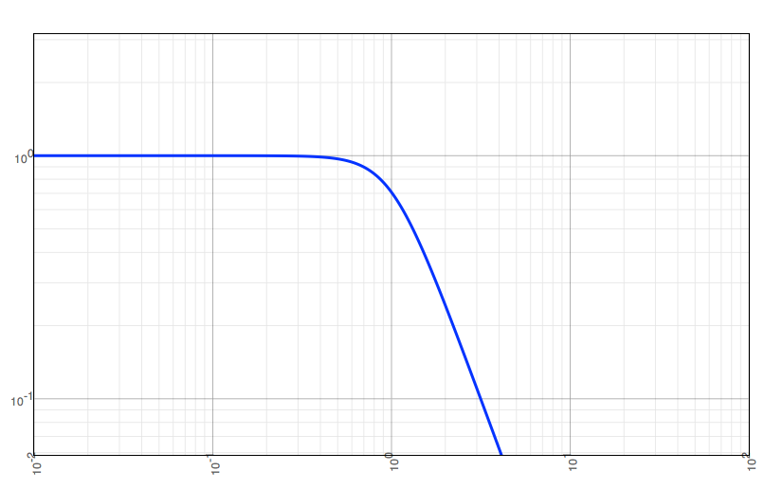
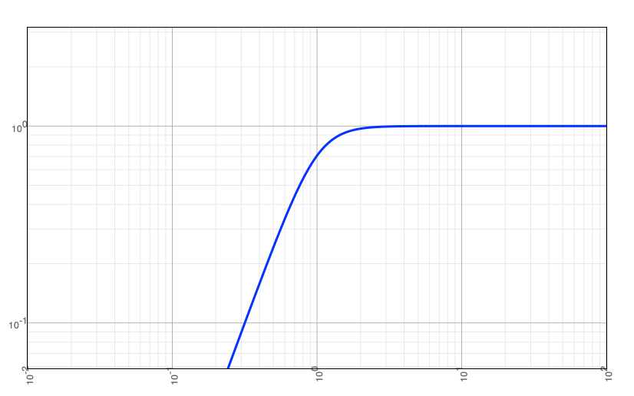
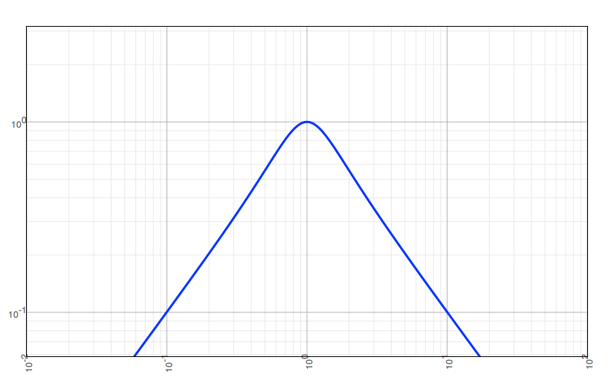
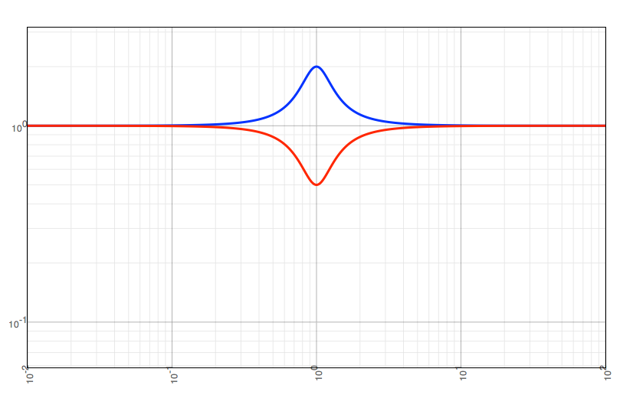
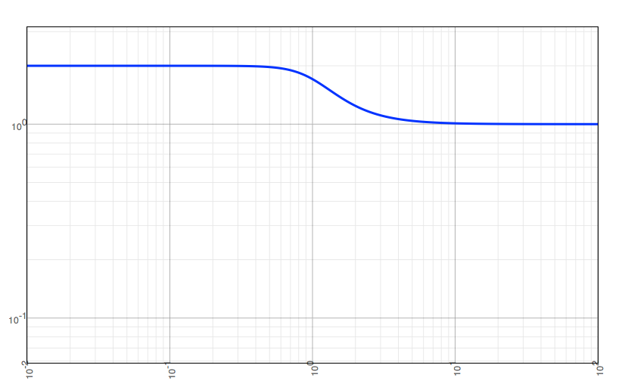
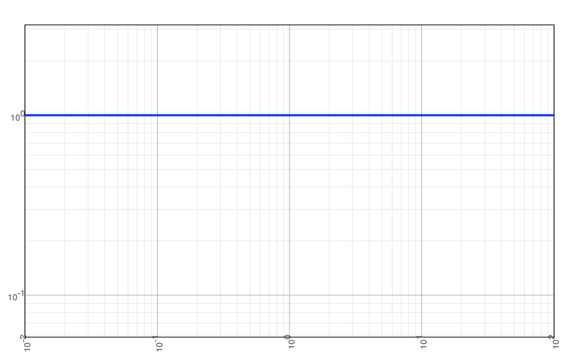
Types of filters
Types we frequently encounter in audio systems:
Lowpass
Highpass
Bandpass
Peaking / Notch
Shelving
Allpass

Slide 7
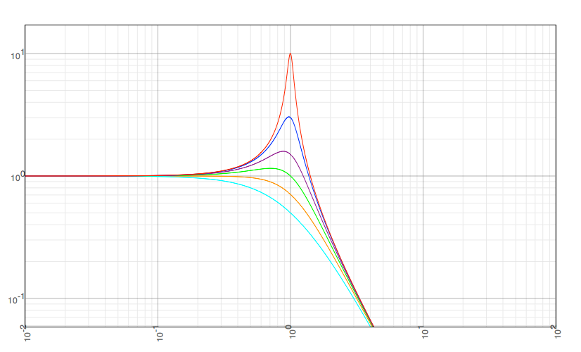
Filter Q
Filters can often be described by “quality factor” Q
Selectivity (bandwidth) relative to centre frequency
Q=Centre frequency / bandwidth = f_{c}/B
Second order
lowpass resonator filters
Q = 0.5
Q = 0.71
Q = 1
Q = 1.5
Q = 3
Q = 10

Slide 8
Filtering in the Web Audio API
Two types of audio nodes for filtering
BiquadFilterNode
2nd order: a₀ y[n] + a₁y[n -1] + a₂y[n-2] = b₀x[n] + b₁x[n-1] + b₂x[n-2]
Parameters specify the filter type and attributes
IIRFilterNode
IIR stands for infinite impulse response
feedback from a₁, a₂, … so it responds forever to a pulse input
to finite impulse response where output depends only on current and previous inputs
Arbitrary order
Parameters specify the filter coefficients
☹ Once the node has been created, you can't change its coefficients

Slide 9
BiquadFilter types and parameters
Type | Description | Frequency | Gain | Q
lowpass | Resonant lowpass filter. Attenuates frequencies above cutoff. | Cutoff frequency | - | Large value makes response more peaked at cutoff
highpass | Opposite of lowpass | Cutoff frequency | - | Large value makes response more peaked at cutoff
bandpass | Passes only frequency band | Center frequency | - | Less bandwidth for high Q
lowshelf | Boosts or cuts lower frequencies | Cutoff frequency | Boost or cut in dB | -
highshelf | Opposite of lowshelf | Cutoff frequency | Boost or cut in dB | -
peaking | Boost or cut frequency band | Center frequency | Boost or cut in dB | Less bandwidth for high Q
notch | Opposite of bandpass | Center frequency | - | Less bandwidth for high Q
allpass | Changes phase relationship between various frequencies | Frequency where phase transition occurs | - | How sharp phase transition is

